Slide 1

Company Overview
May, 2025

Slide 2


Our Vision, Mission and Values
We transport the goods that enrich and connect the lives of our customers and communities
Mission
Vision
Values
Safety
People
Customer Focus
Agility
Reliability
To be the best-in-class cargo carrier in the markets we serve

Slide 3

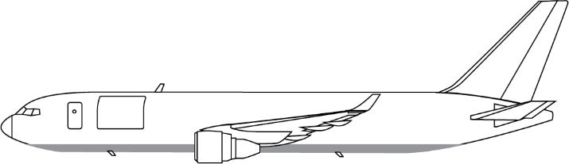
Operating a Fleet of 12 Aircraft
CMI/3 Boeing 767-300F
9 Boeing 767-300F
Payload Gross
55,000 kg 121,000 lbs.
Payload Net
51,000 kg 112,000 lbs.
Volume (MD)
10,947 ft³ 310 M³
Volume (LD)
3,750 ft³ 106 M³
Updated:02/05/25

Slide 4
Diversified Service Offerings
Amerijet has developed a range of offerings ideally suited for B2B, B2C, Government, and Emergency Relief shipments worldwide.
Scheduled Service
Scheduled Service transports time-sensitive, perishable, oversized, hazardous, and highly specialized products where air transportation is the only viable option.
Contracted Service
ACMI/CMI and long-term agreements with key customers under which Amerijet operates entire cargo aircraft on their behalf.
DoD
Chartered services under various programs (e.g., CRAF) for the U.S. Department of Defense
Ad Hoc Charters
Short-term and ad hoc charters for various industries and on behalf of logistics providers and freight forwarders.

Slide 5
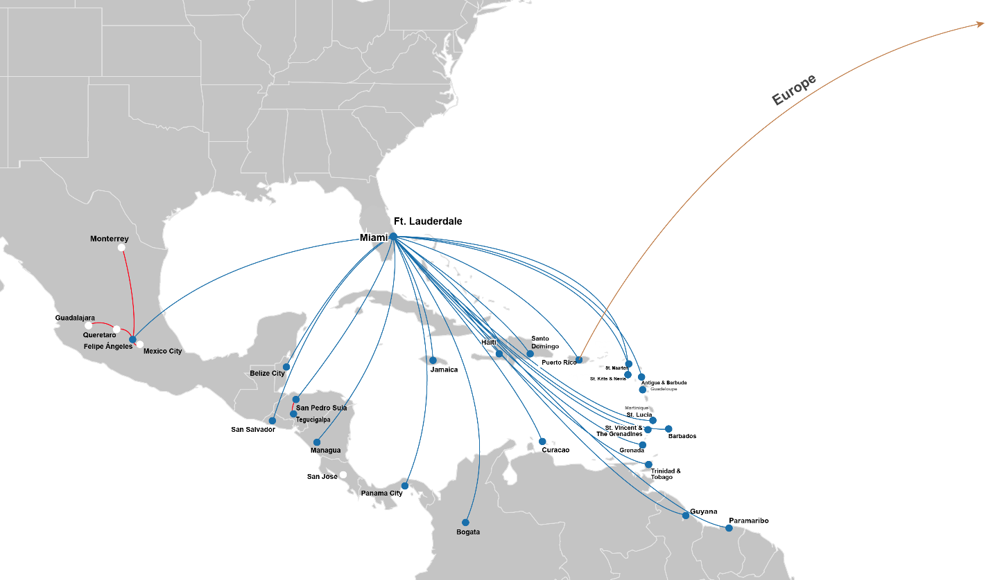
Amerijet Scheduled Service Routes
Expanded network capabilities and global reach:
  104 U.S. Trucking Connections linking major U.S. cities to Miami Hub
  70 European Trucking Connections ensuring seamless regional transport
  80 Interline Agreements covering 345 cities worldwide for extended connectivity

Slide 6
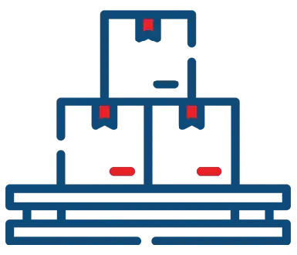








Commodities
General Cargo Perishable Dangerous Goods
Pharmaceuticals Oversized/Heavy Freight Live Animals & Poultry
High Value Human Remains

Slide 7
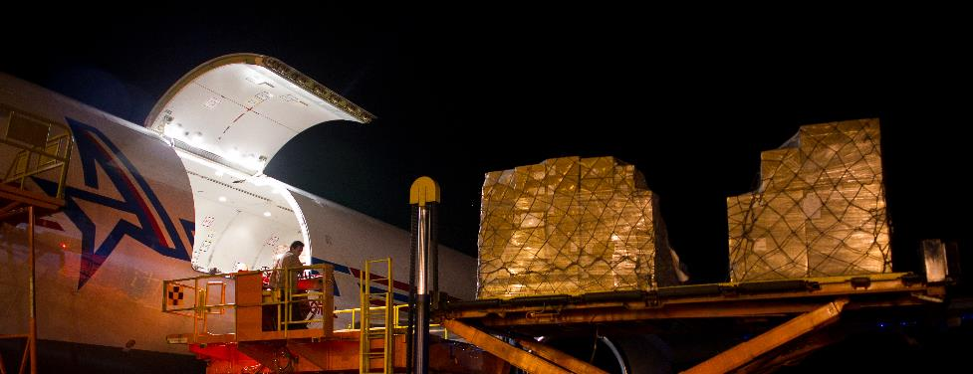
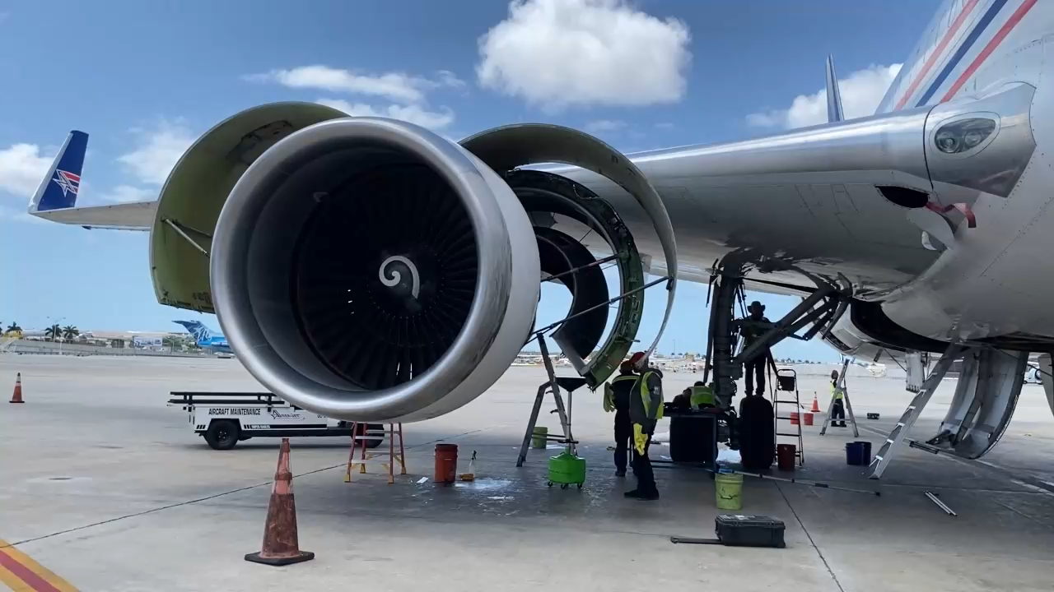
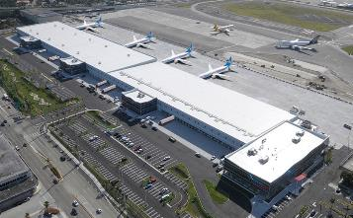
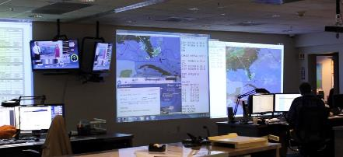
Amerijet Hub - Miami
Dedicated aircraft parking
Less than 5 minutes of tarmac transfers
Acceptance of palletized freight and containers on both landside and airside to streamline flows and cut receiving times.
Customs and Agriculture inspection onsite
Dangerous Goods/Hazmat inspection
24/Hr. Security and surveillance

Slide 8

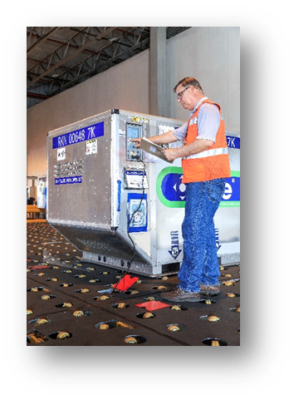
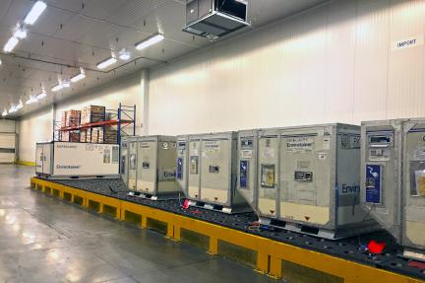
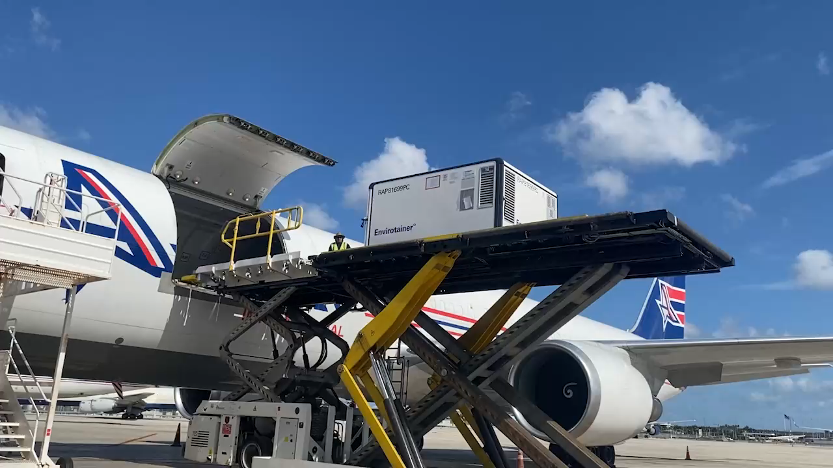
Miami Hub Pharmaceutical &
Cold Chain Products
Dedicated storage coolers for temperatures ranging
between:
  +15°C and +25°C
  +2°C and +8°C
  -20°C Active containers
24/Hr. Security and surveillance
Temperature-controlled food products
Temperature-controlled pharmaceuticals include vaccines, clinical trials, blood products
Non-temperature-controlled pharmaceuticals, including medical and laboratory devices and equipment, and solid pharmaceuticals, such as pills, tablets, and lozenges
Hazardous and radioactive pharmaceuticals and medical waste

Slide 9













Industries We Serve
Logistics & Supply
Aerospace & Aviation
Automotive
Pharmaceuticals & Healthcare
Energy & Oil/Gas
Manufacturing & Industrial Goods
Fresh Produce Industry
Fishing Industry
Floral Industry
Live Animals & Specialty Cargo
Retail & E-commerce
Humanitarian & Relief Aid

Slide 10

Thank You!

Slide 11

Video

